Slide 1

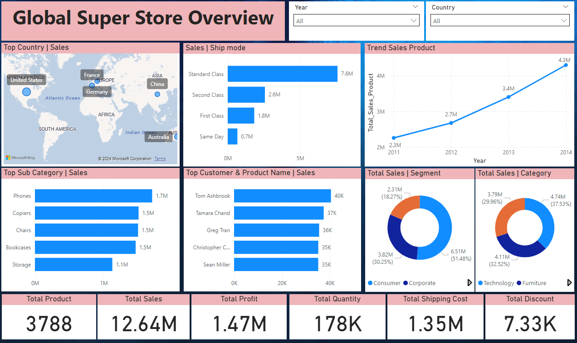
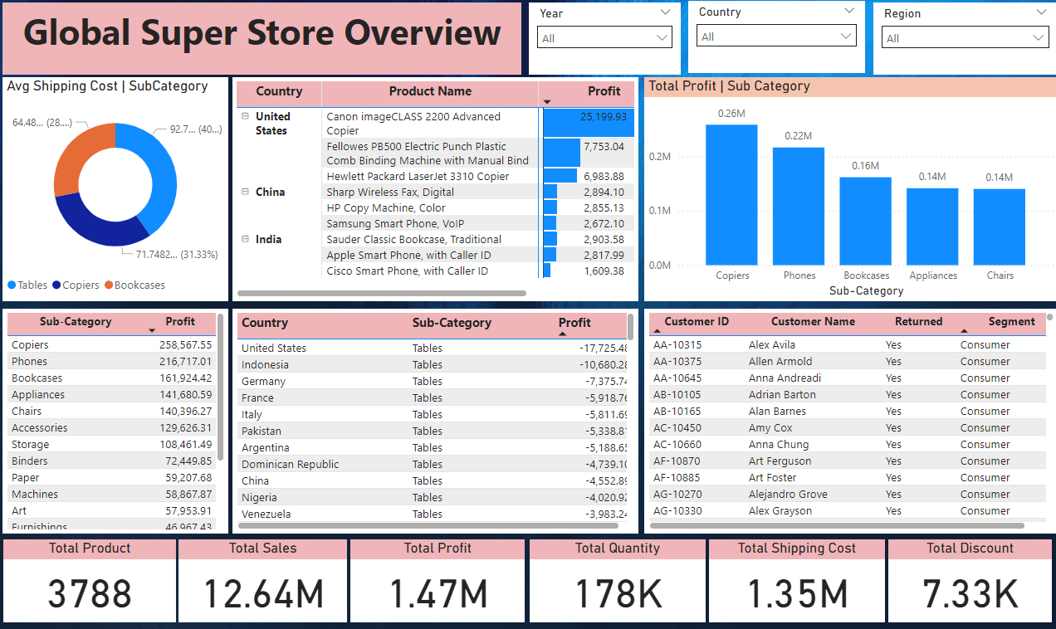
SALES DASHBOARD (with POWR BI)
Objective :
Gain insight from visualisation, to get support smart and accurate business decisions
Description :
on this dashboard we will be able to review daily sales activities which can analyse base on several aspect including : monthly trend, top product sale, top customer, top countries and so on. Specially this dashboard is very interactive

